Slide 1
Cosmological N-Body Simulations
Joe Chen

Slide 2

Two kinds of people in this world.

Slide 3

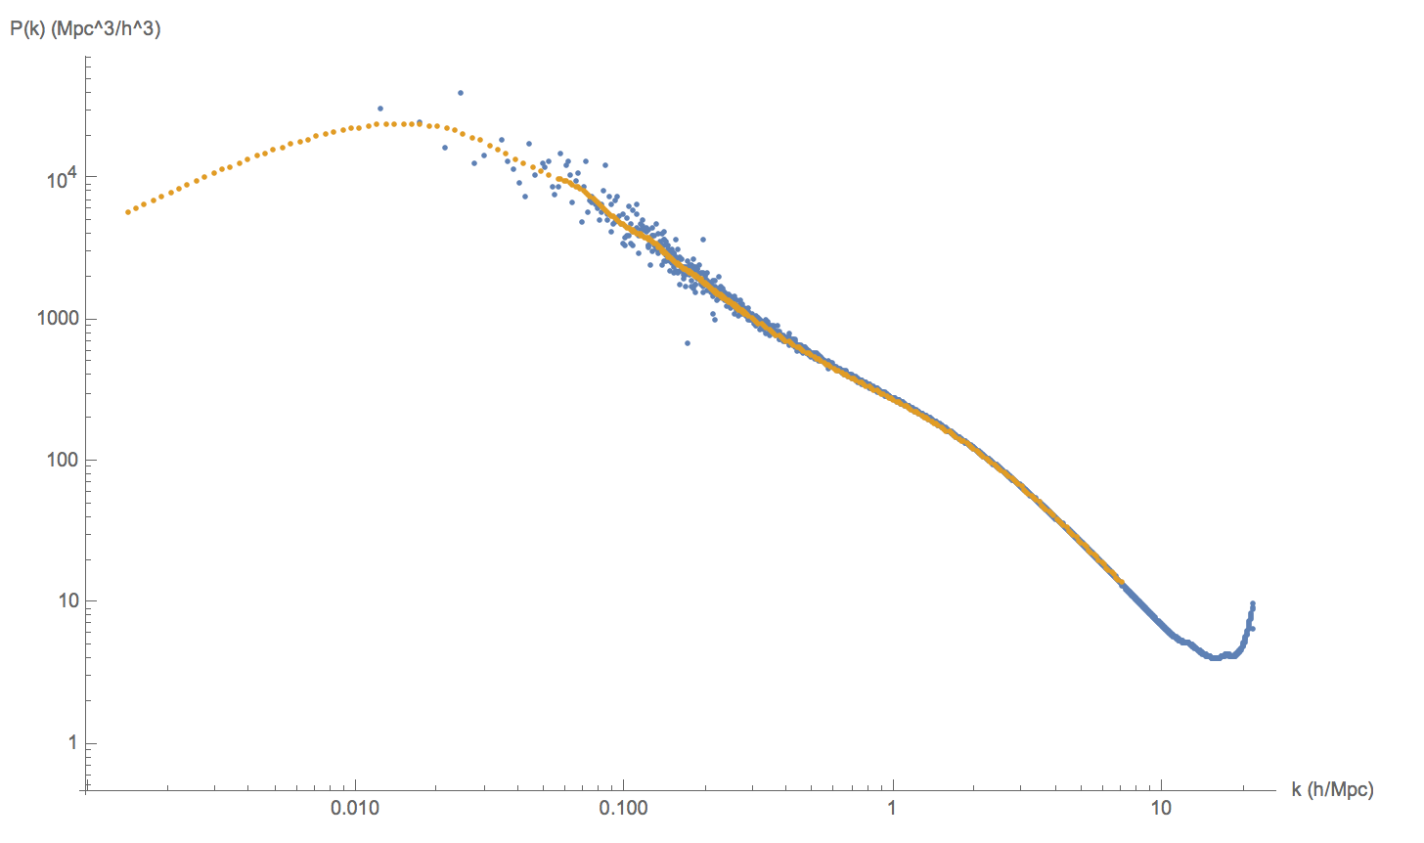

Slide 4
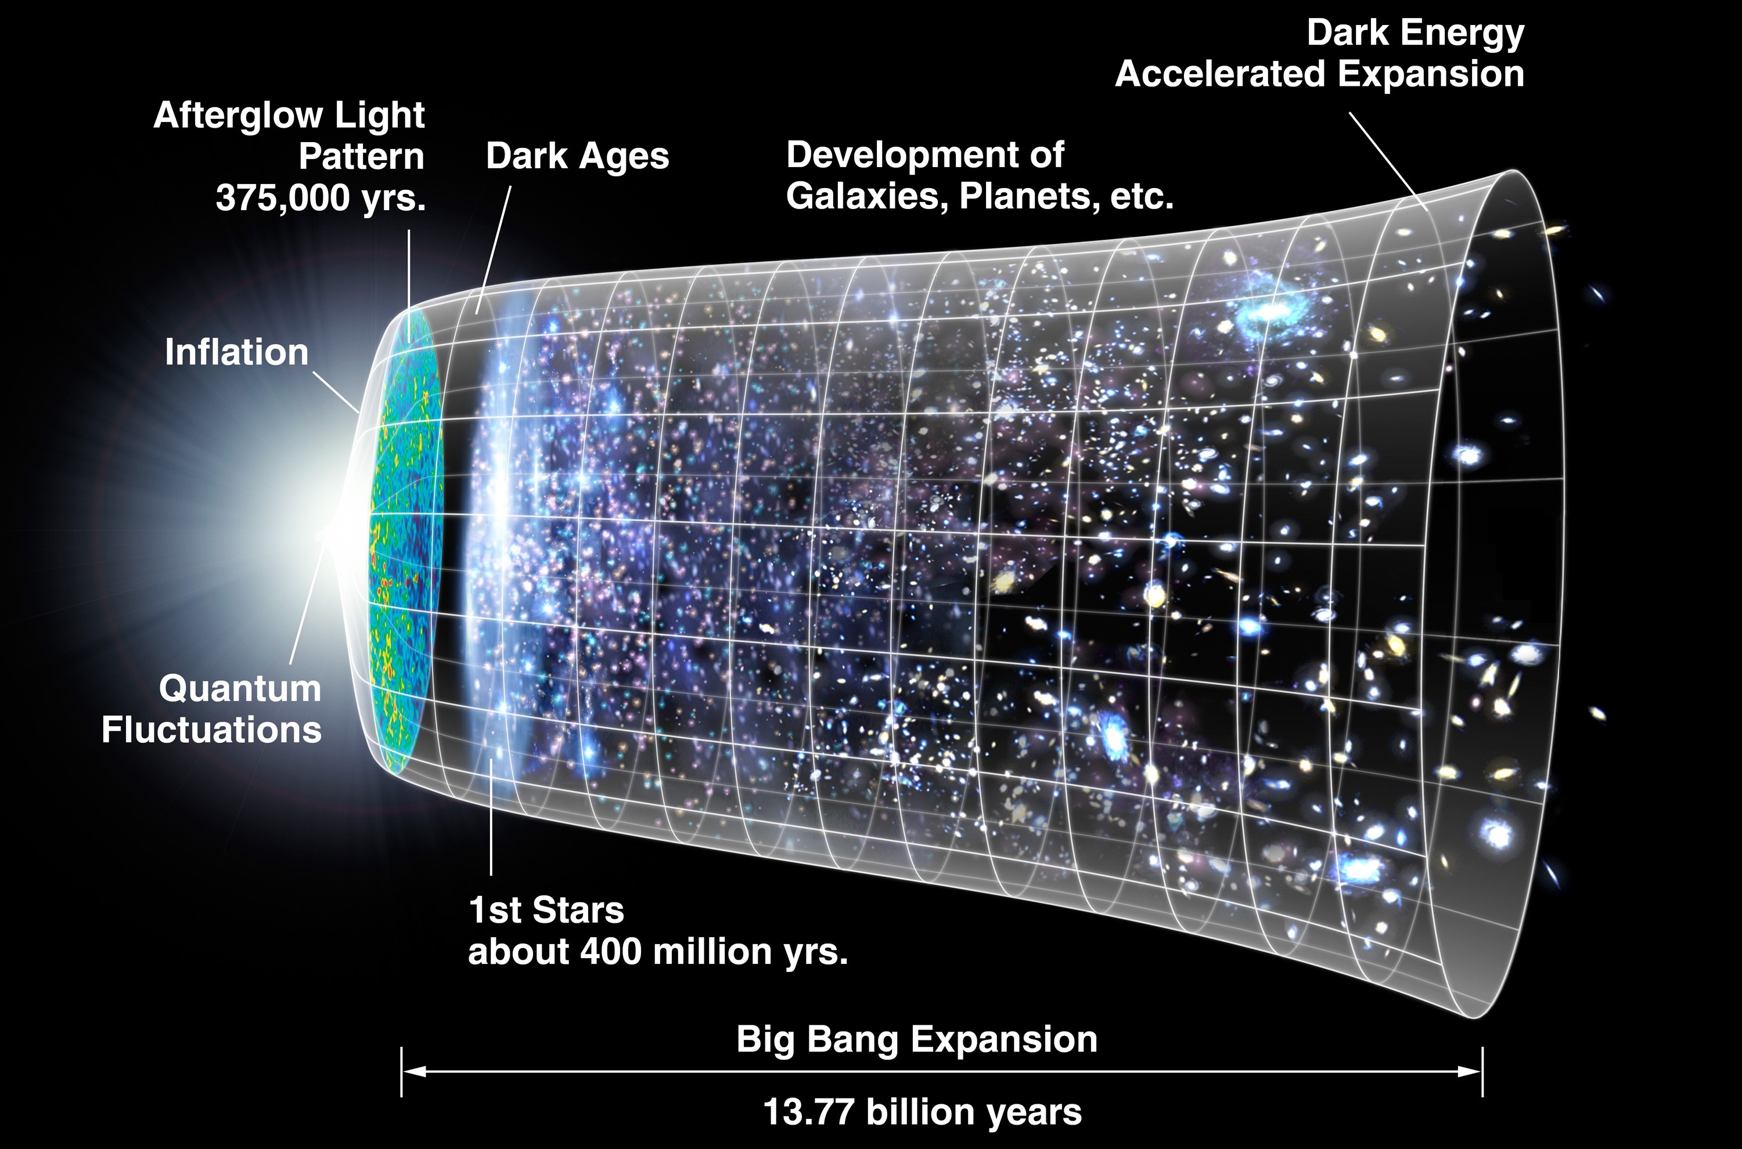

The Universe
- Formation and Evolution
Gravitational dynamics.
Formation of stars, galaxies, clusters, large scale structures.
Depends on how we begin, and what we have.

Slide 5
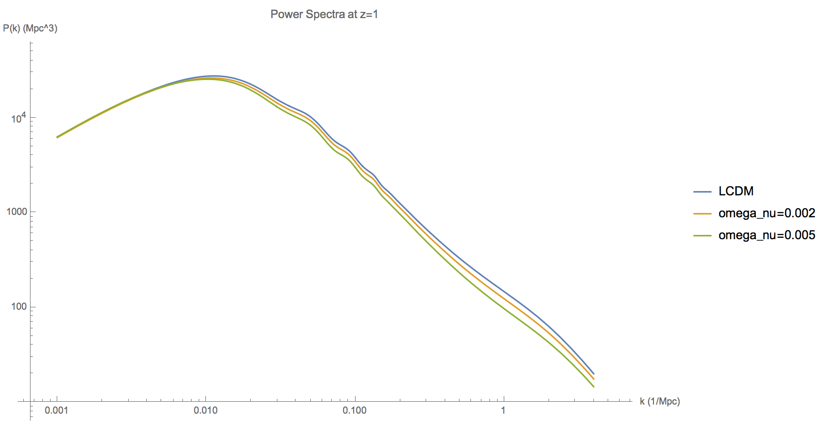
The Power Spectrum
Power spectra calculated with the Mira-Titan emulator. arXiv:1705.03388

Slide 6
Linear Perturbation Theory
Accurate for large scales (small k values).
Well understood.
Easily obtainable from Boltzmann codes, i.e. CLASS, CAMB.
Breaks down eventually.

Slide 7
Non-Linear Power Spectrum
Clustering of matter, non-linear collapse.
This is difficult to calculate from any analytical approach.
Brute force: N-body simulations.
Future surveys, i.e. Euclid, LSST, SKA. Require sub-percent level predictions.

Slide 8
N-Body Simulations
Newtonian gravity.
Computationally extremely expensive.
Large number of particles needed.
Brute forced, but try to be smart where possible.

Slide 9
What’s in the Box Currently?
Cold dark matter.
Dark energy in the form of a cosmological constant.
Gadget-2 does this very well.

Slide 10
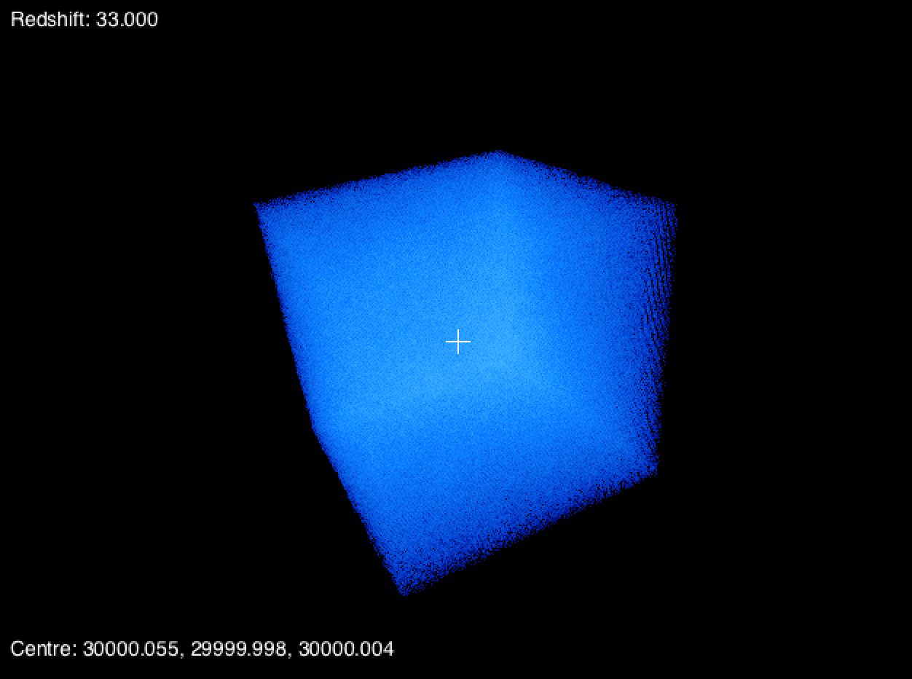
Lambda-CDM Simulation
Created with Gadget-2, V. Springer

Slide 11
Adding Neutrinos
Tracking relativistic neutrino particles = difficult.
Particle numbers increase dramatically to account for both CDM and neutrinos.
Previously shown, linear neutrinos.
Fluid approach, - Courant condition is a bottle neck.

Slide 12
Hybrid Approach
Early times, model neutrinos with perturbation theory.
Convert them to particles when non-linear effects become important.
Binning neutrinos by momentum - staggered conversion.
Exactly how to “correctly place” the particles into the box will need closer inspection.

Slide 13
Conclusion
Future surveys capable of measuring non-linear regimes down to percent level.
Neutrinos are very important and we need a reliable way to simulate their effects on large scale structure.
Implementation of hybrid neutrino simulation on my to-do-list.
“The problem is not the problem. The problem is your attitude about the problem.”
– Captain Jack Sparrow

